Slide 1
Non-rigid Registration of 3D Ultrasound Images Using Model-based
Segmentation
CVPR Workshop on Registration of Very Large Images
Columbus, OH
June 23rd, 2014
Babak Matinfar & Lyubomir Zagorchev
Philips Research NA
345 Scarborough Road, Briarcliff Manor, NY

Slide 2
Motivation
Non-rigid registration computational performance depends on the image size
Voxel-based approaches are computationally intensive, exponentially proportional to image resolution
An approach that is independent of the image size
Registration computation speed remains constant with increasing image resolution

Slide 3
Method
Model based segmentation:
Fully automated, rapid and highly accurate segmentation on 3D volumes
Fixed mesh topology for point correspondence between segmented volumes
Thin plate spline (TPS) registration
TPS applied to segmented meshes from 4D echocardiogram images

Slide 4
Frame Extraction
4D Echocardiography
Frame Extraction
Reference 3D ultrasound volume
Target 3D ultrasound volume
Model based segmentation
Model based segmentation
3D mesh
3D mesh
Control Points
TPS Registration
Control Points
Registered reference and target images

Slide 5
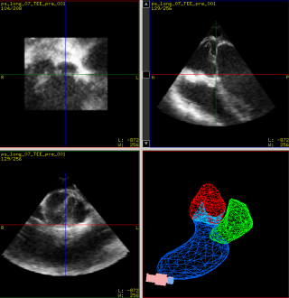
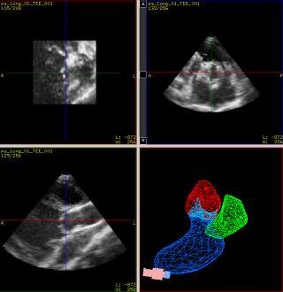
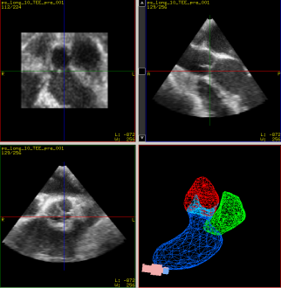
3D ultrasound volumes were extracted from 4D echocardiography at different points in the cardiac cycle

Slide 6
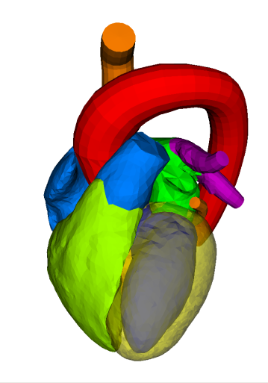
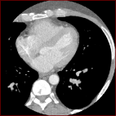
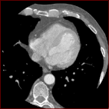
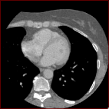
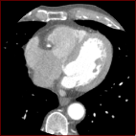
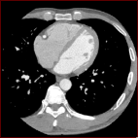
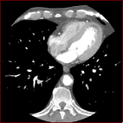
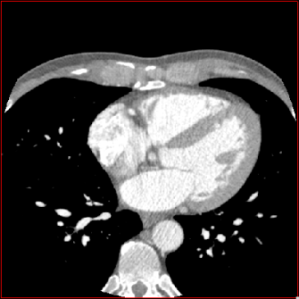
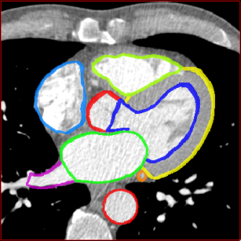
Shape-constrained Deformable Models
Training
Anatomical knowledge Sample images Generic model
+
⇒
Adaptation
Generic model New image Adapted model
+
⇒

Slide 7
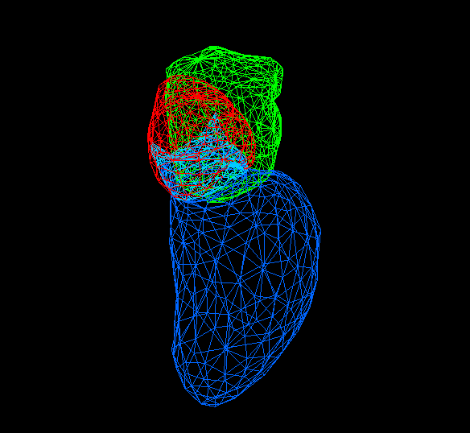
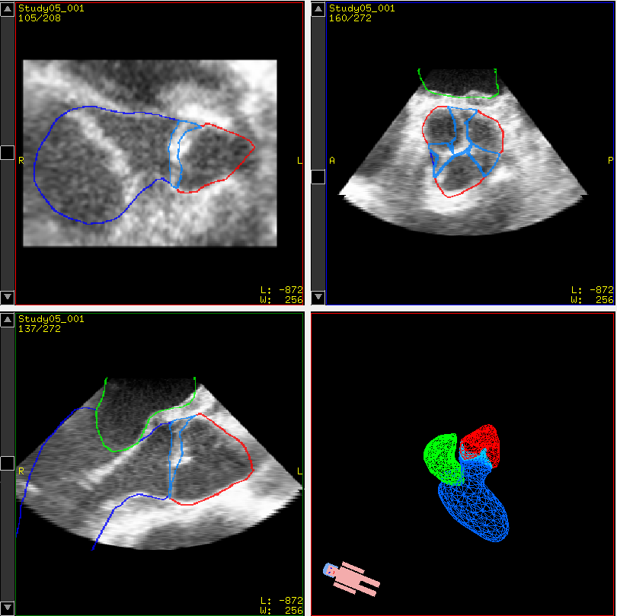
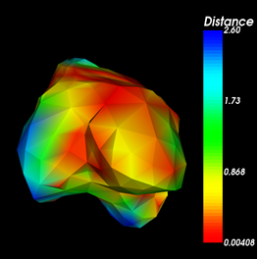
Segmentation of heart aortic root model
Distance error

Slide 8
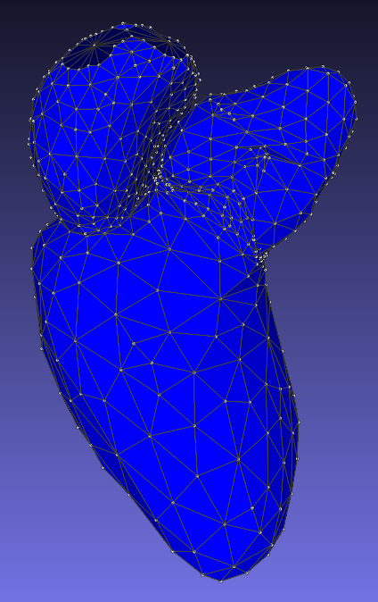
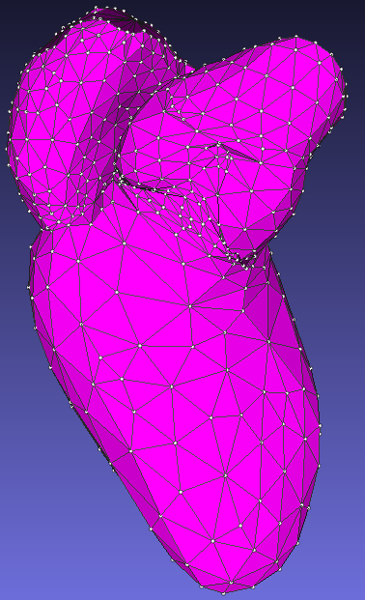
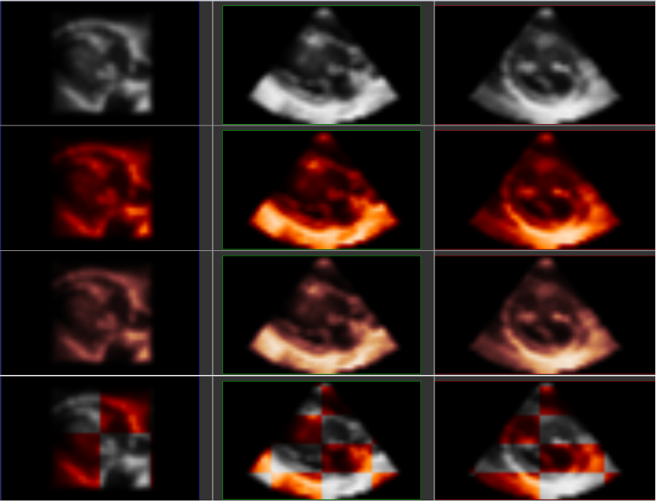
TPS registration of control points

Slide 9
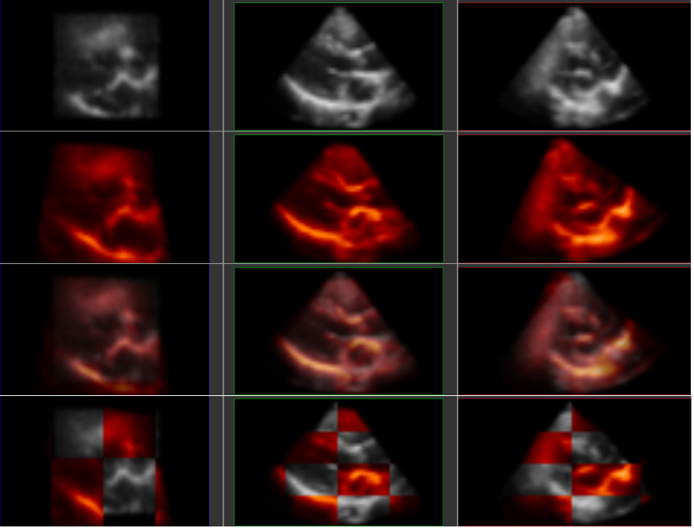
Results: Inter-Patient Registration
Not Registered
Registered
Image overlay of end of diastole to end of systole volumes in cardiac cycle

Slide 10
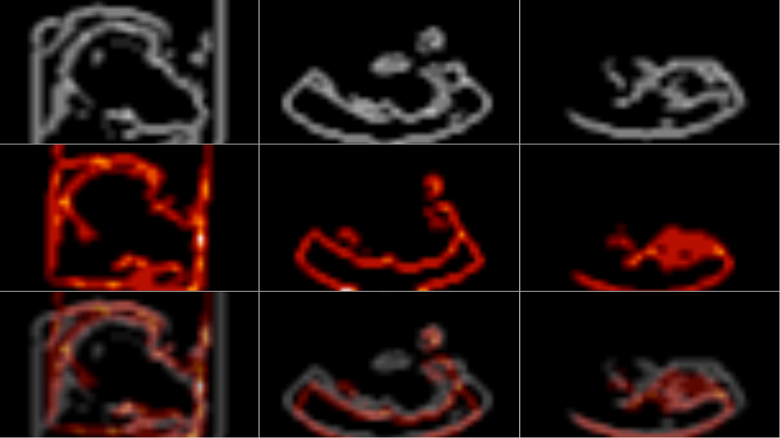
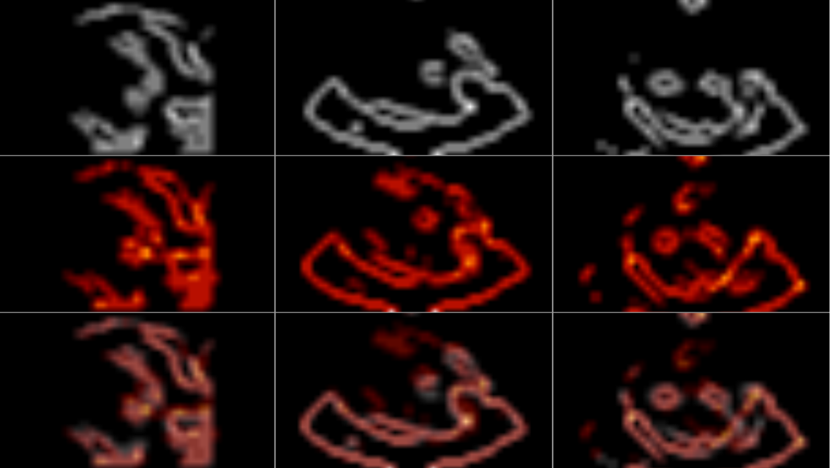
Results: Inter-Patient Registration
Not Registered
Registered
Overlay of image boundaries of end of diastole to end of systole volumes in cardiac cycle

Slide 11
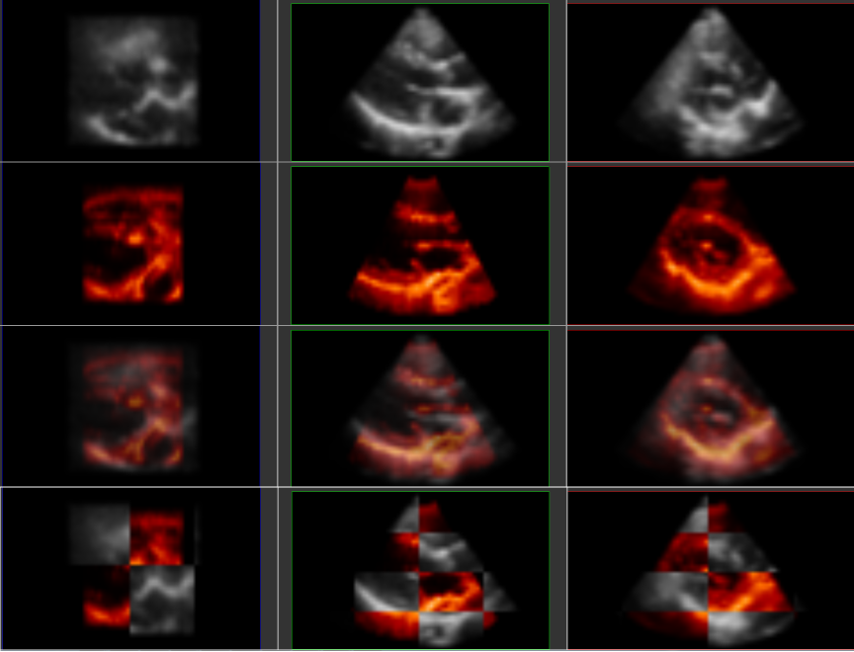
Results: Intra-Patient Registration
Not Registered
Registered
Image overlay of end of diastole volumes in different patients

Slide 12
Conclusion
Method for non-rigid registration of large 3D data volumes that does not depend on the image size and any intensity-based similarity metrics
Rapid segmentation provides accurate point-based correspondence that can be used for TPS registration
Registration computational performance remains constant with increasing image size and resolution

