Slide 1

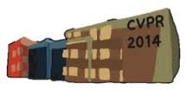

Image Registration of Very Large Images via Genetic Programming
Sarit Chicotay Omid E. David Nathan S. Netanyahu
Department of Computer Science
Bar-Ilan University
Ramat-Gan, Israel

Slide 2
Motivation for GP-Based IR
Typical IR techniques exploit specific domain knowledge and make certain a priori assumptions.
  e.g., transformation model, model parameter bounds, etc.
Very large images likely to give rise to more complex transformations, which standard techniques might not handle effectively
  e.g., deformations and other distortions
Genetic programming (GP)-based approach could offer potentially significant advantage by searching for a complex transformation without prior assumptions.

Slide 3



















Principles of Evolutionary Computation (EC)
Algorithm maintains a population of candidate solutions for the problem represented by chromosomes
The properties of a chromosome are coded by its genes.
Fitness of a chromosome is measured by quality of solution it represents
Population
Population
$$0.13$$
$$32.25$$
$$12.14$$
$$16.52$$
$$2.54$$
$$f\left( \right)=32.25$$
$$16.01$$
$$8.22$$
$$f\left( \right)=16.01$$
…
$$41.1$$
$$12.52$$

Slide 4
Genetic Evolution (1)
The algorithm iteratively evolves a solution to the problem.
New generation created by selection of parent chromosomes based on their fitness.
  “Better” individuals more likely to survive (survival of the fittest)
  Different selection strategies, e.g., roulette-based, rank-based, etc.
Reproduction occurs, producing new children chromosomes (of new generation) from their parents:
  Crossover / recombination
    Children formed by combination of their parent’s genes
  Mutation
    Introducing “errors” during gene duplication (with low probability)

Slide 5











Genetic Evolution (2)
Selection
Elitism selection allows better chromosome(s) to carry over to next generation.
Solution is the best chromosome in last generation
Population
Process repeats until termination criteria met:
  No significant change in fitness (over many generations)
  Best solution satisfies a quality condition
  # of iterations
Mutation
Recombination

Slide 6
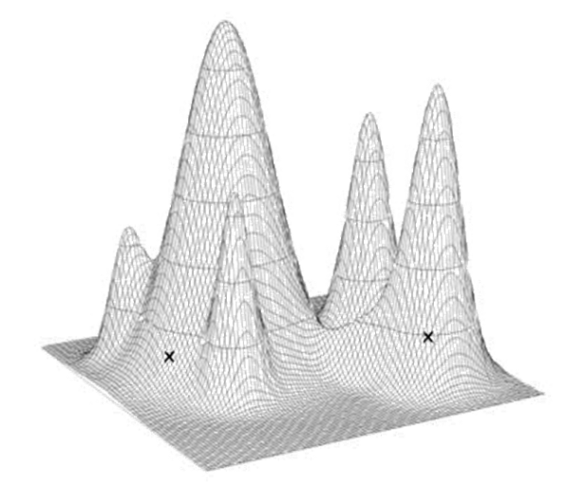
Rationale of Evolutionary Computation (EC)
Gradual improvement of population is expected across generations:
  “Survival of the fittest”, i.e., better solutions more likely to reproduce and preserve their genes (partial solution).
  Crossover should combine “good” genes (partial solution) of “good” solutions and improve them.
  Mutation avoids local minima.
  Elitism selection ensures best solution can only be improved.
The algorithm is inherently parallel, exploring several solutions simultaneously.
Many applications in diverse fields including IR
  e.g., economics, quality control, game theory, etc.

Slide 7
Genetic Programming (GP)
Genetic Programming (GP), introduced by John R. Koza (1990)
GP is part of a family of evolutionary algorithms (EAs), a rapidly growing area of artificial intelligence inspired by natural evolution.
EAs are stochastic optimization methods aimed at finding an ‘’optimal’’ solution wrt certain objective(s).

Slide 8
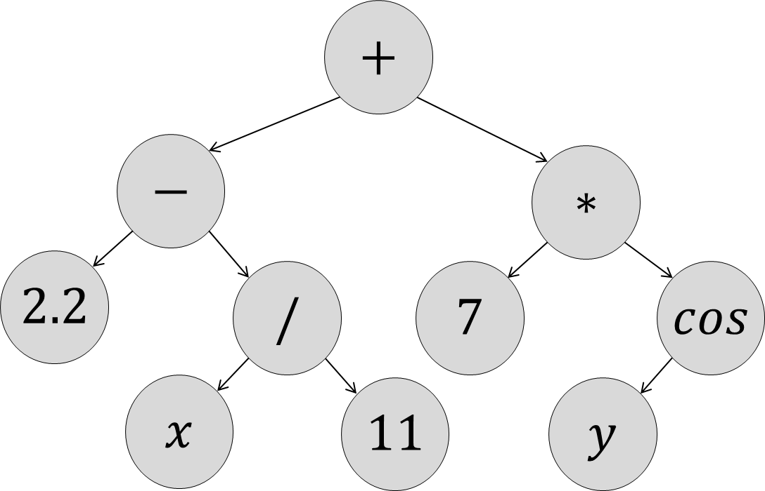
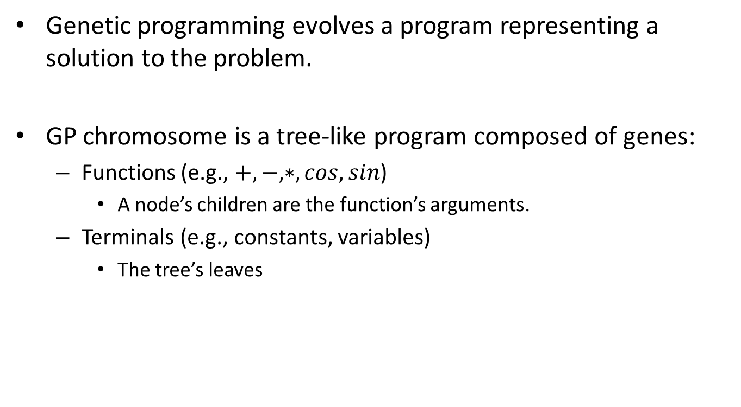
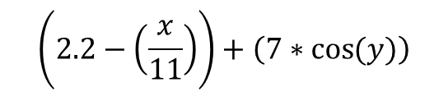
GP Chromosome
Genetic programming evolves a program representing a solution to the problem.
GP chromosome is a tree-like program composed of genes:
  Functions (e.g., $+,−,∗,cos,sin$)
    A node’s children are the function’s arguments.
  Terminals (e.g., constants, variables)
    The tree’s leaves
$$\left(2.2−\left(\frac{x}{11}\right)\right)+\left(7∗\cos{(y)}\right)$$

Slide 9

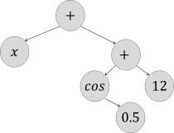
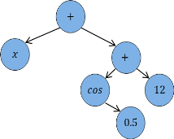
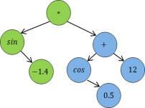
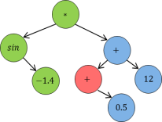
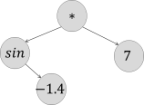
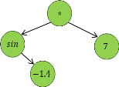



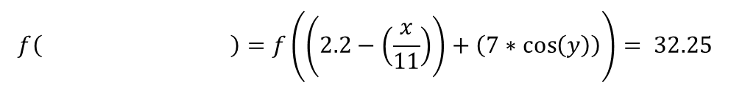
GP Evolution
Fitness of a GP chromosome is measured by quality of the solution it represents.
Population improves iteratively
$$f\left( \right)=f\left(\left(2.2−\left(\frac{x}{11}\right)\right)+\left(7∗\cos\left(y\right)\right)\right)= 32.25$$
Population
Selection
Recombination
Mutation

Slide 10
Evolutionary IR
EAs have been successful during past decades in solving a variety of search and optimization problems, including IR.
Most EA studies for IR represent a genetic algorithm (GA)-based approach.
  A priori assumption made about the transformation model (e.g., similarity transformation).
  Search for optimal transformation is carried out through space of transformation parameters.
In contrast, GP-based approach is not limited to a predefined number of parameters
  Makes no prior assumptions about the transformation model
  Use of “proper” building blocks may yield, in principle, any transformation

Slide 11
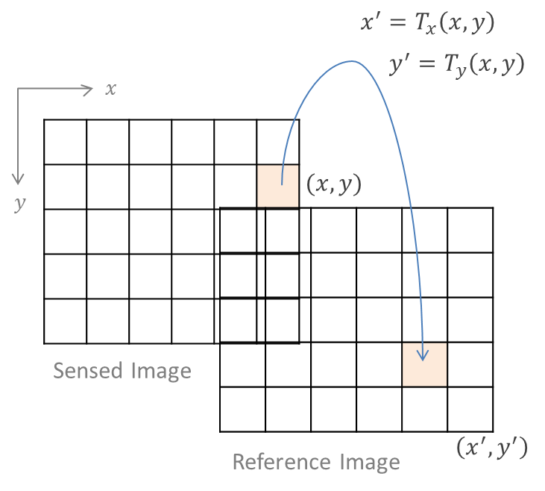







GP-Based IR
Each chromosome composed of two trees for the transformation of $x$ and $y$ coordinates.
$x$-tree
$y$-tree
$$T_{x}\left(x,y\right)=$$
$$=T_{y}\left(x,y\right)$$

Slide 12
Fitness Evaluation
Mutual information (MI) has been applied in a robust and efficient manner to IR as a measure of statistical dependency between the gray values of two images.
  Maximal dependency is expected when the images are correctly aligned
  Misregistration results in a decrease of this measure
  Applied in diverse fields (e.g., Medical Imaging) for various transformations
MI is used as fitness function, i.e., measure for transformation quality.
Sampling strategy for efficient computation
  Fitness computed for only 5% of pixels (random).
  If overlap degree wrt these pixels is smaller than a threshold, chromosome discarded.

Slide 13
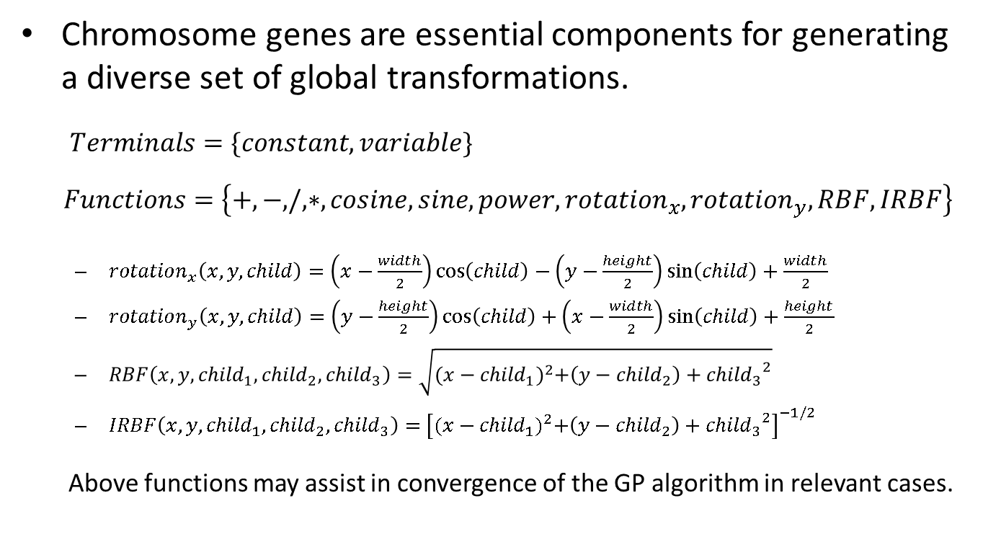
Transformation Representation
Chromosome genes are essential components for generating a diverse set of global transformations.
$Terminals=\{constant, variable\}$
$$Functions=\left\{+,−,/,∗,cosine,sine,power,{rotation}_{x},{rotation}_{y},RBF,IRBF\right\}$$
  ${rotation}_{x}\left(x,y,child\right)=\left(x−\frac{width}{2}\right)\cos\left(child\right)−\left(y−\frac{height}{2}\right)\sin\left(child\right)+\frac{width}{2}$
  ${rotation}_{y}\left(x,y,child\right)=\left(y−\frac{height}{2}\right)\cos\left(child\right)+\left(x−\frac{width}{2}\right)\sin\left(child\right)+\frac{height}{2}$
  $RBF\left(x,y,{child}_{1},{child}_{2},{child}_{3}\right)=\sqrt{{(x−{child}_{1})}^{2}+\left(y−{child}_{2}\right)+{{child}_{3}}^{2}}$
  $IRBF\left(x,y,{child}_{1},{child}_{2},{child}_{3}\right)=$ ${\left[{(x−{child}_{1})}^{2}+\left(y−{child}_{2}\right)+{{child}_{3}}^{2}\right]}^{−1/2}$
  Above functions may assist in convergence of the GP algorithm in relevant cases.

Slide 14
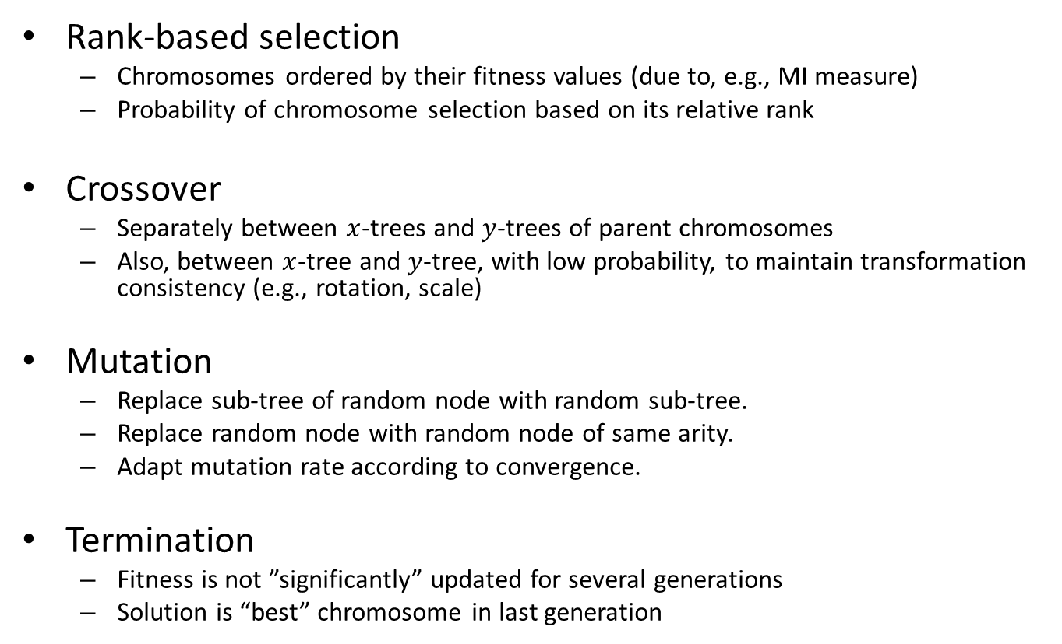
Evolving Transformation
Rank-based selection
  Chromosomes ordered by their fitness values (due to, e.g., MI measure)
  Probability of chromosome selection based on its relative rank
Crossover
  Separately between -trees and -trees of parent chromosomes
  Also, between -tree and -tree, with low probability, to maintain transformation consistency (e.g., rotation, scale)
Mutation
  Replace sub-tree of random node with random sub-tree.
  Replace random node with random node of same arity.
  Adapt mutation rate according to convergence.
Termination
  Fitness is not ”significantly” updated for several generations
  Solution is “best” chromosome in last generation

Slide 15
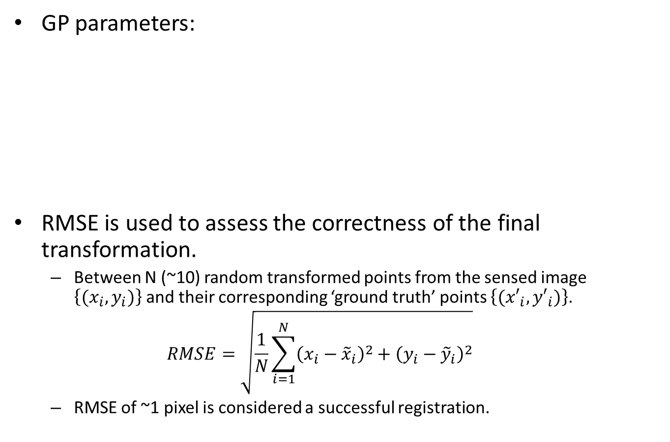
Initial Results
GP parameters:
RMSE is used to assess the correctness of the final transformation.
  Between N (~10) random transformed points from the sensed image $\left\{(x_{i},y_{i})\right\}$and their corresponding ‘ground truth’ points $\left\{({x′}_{i},{y′}_{i})\right\}$.
  $$RMSE=\sqrt{\frac{1}{N}\sum_{i=1}^{N}{{\left(x_{i}−{\tilde{x}}_{i}\right)}^{2}+{\left(y_{i}−{\tilde{y}}_{i}\right)}^{2}}}$$
  RMSE of ~1 pixel is considered a successful registration.
150 | Population size
0.9 | Crossover probability
0.3 | Mutation rate
3/150 | Elitism
6 | Initial tree max. height
3 | Mutation max. height

Slide 16
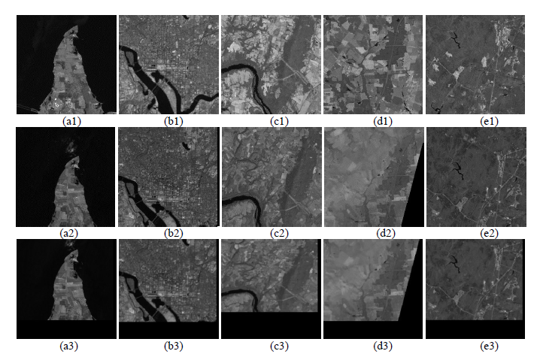
Results (1)
256x256 pairs of Landsat 7 images over the Washington, DC area successfully registered (RMSE ~1 pixel).
  Compared with a SIFT-based method (similar results)

Slide 17

Results (2)
5351x5051 image (~27M pixels) of Landsat-7 images over Colorado
Semi-synthetic image pair (translation only)
Ground truth: $T_{x}\left(x,y\right):x−50$, $T_{y}\left(x,y\right):$ $y−100$
Successful registration (RMSE ~1 pixel)
GP solution: $T_{x}\left(x,y\right):$((-56.59)+x)+2.71828
$T_{y}\left(x,y\right):$ ((y+((-297.67)/2.71828))+(y/y))+2.71828
Not concerned about non-conventional transformation expression, as long as alignment is sufficiently accurate.

Slide 18
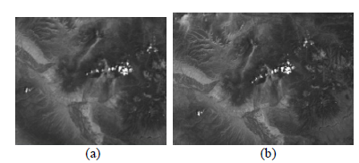

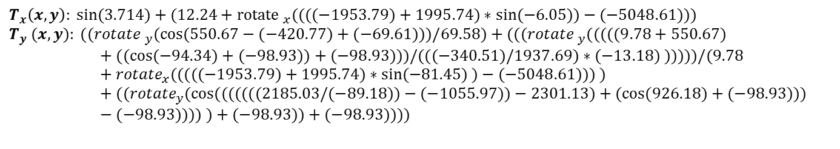
Results (3)
5351x5051 image (~27M pixels) of Landsat-7 images over Colorado
Semi-synthetic image pair using both rotation and translation
Ground truth:
Registration result: RMSE ≈6 pixel.
GP solution:
$T_{x}\left(x,y\right):{rotate}_{x}\left(0.2618\right)+15$, $T_{y}\left(x,y\right):{rotate}_{y}\text{(}\text{0.2618}\text{) – }\text{165}$
$$T_{x}\left(x,y\right): sin⁡(3.714)+(12.24+{rotate }_{x}((((−1953.79)+1995.74)∗sin⁡(−6.05))−(−5048.61)))$$
$$T_{y} (x,y): (({rotate }_{y}(cos⁡(550.67−(−420.77)+(−69.61)))/69.58)+((({rotate }_{y}(((((9.78+550.67)+((cos⁡(−94.34)+(−98.93))+(−98.93)))/(((−340.51)/1937.69)∗(−13.18) )))))/(9.78+{rotate}_{x}(((((−1953.79)+1995.74)∗sin⁡(−81.45) )−(−5048.61))) )+(({rotate}_{y}(cos⁡(((((((2185.03/(−89.18))−(−1055.97))−2301.13)+(cos⁡(926.18)+(−98.93)))−(−98.93)))) )+(−98.93))+(−98.93))))$$

Slide 19
Future Directions
Experiment with more complex datasets, containing deformations and other distortions
Experiment with additional similarity metrics (other than MI) used in IR as quality measure
  e.g., partial Hausdorff distance, cross-correlation, sum of squared intensity
Incorporate additional functional building blocks to speed up convergence of GP algorithm.
Explore various GP aspects
  e.g., larger population vs. number of generations, mutation rate, islands, etc.

Slide 20
Challenges
Computation time
  e.g., parallelism, hierarchical processing, sampling strategy (using fraction of the pixels), etc.
Bloat phenomenon reflects growth of a genetic program without (signiﬁcant) ﬁtness improvement
  Basic parsimony pressure method used (i.e., penalty proportional to program tree size); to be explored

Slide 21
Summary
The GP approach attempts to provide a robust and automatic solution without assuming a specific transformation model.
Initial results show promise for evolutionary approach for IR of (very) large images that give rise to more complex transformations.
Accuracy of initial results comparable to other IR method(s)
Future research will focus on more complex datasets and transformation types.

